Slide 1

Introduction to NodeMCU
DAY 26
EMBEDDED SYSTEM DESIGN & IoT-Master Class

Slide 2
What You will learn Today?
What is Node MCU
Features of Node MCU
Blink LED,UART,Switch

Slide 3
Mindset Lesson for the Day
Success Loves Speed.
The longer you wait to do something, the chances are you may never do it.
Don’t wait for perfection-Just Do It.

Slide 4
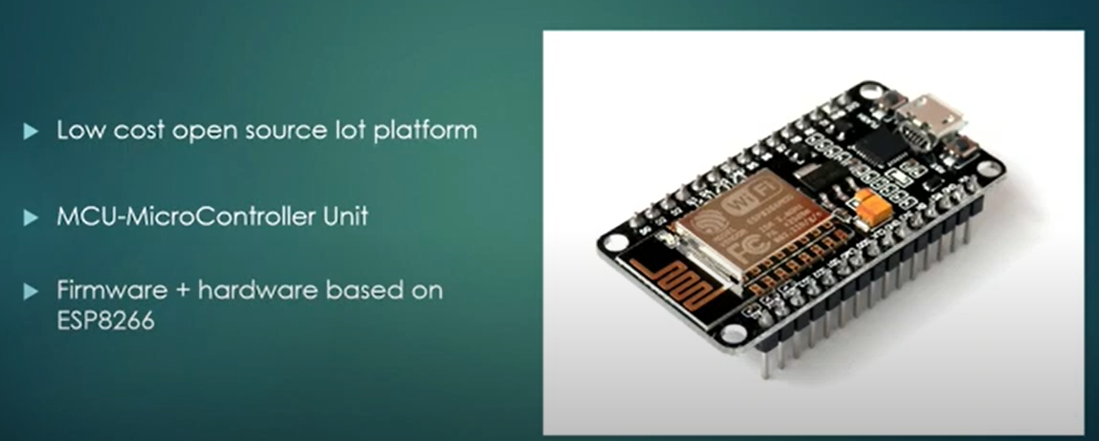
What is NodeMCU

Slide 5
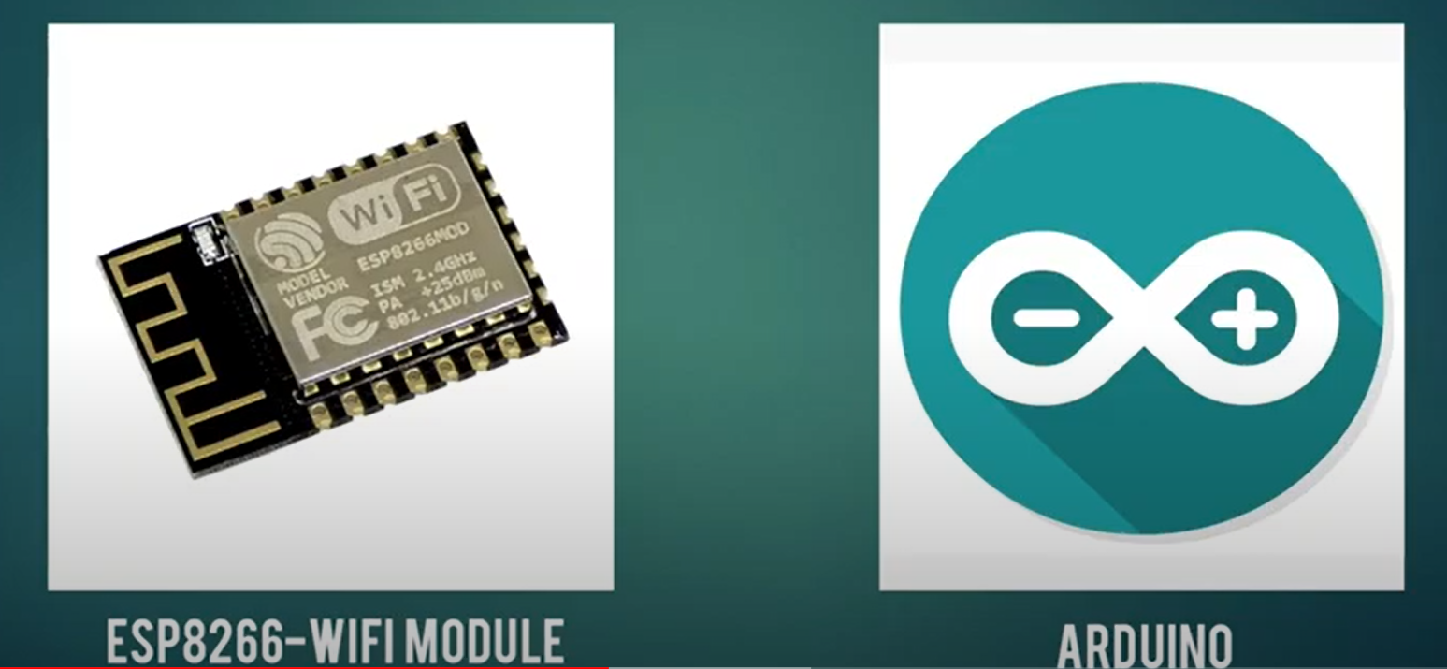
Why is so Popular

Slide 6
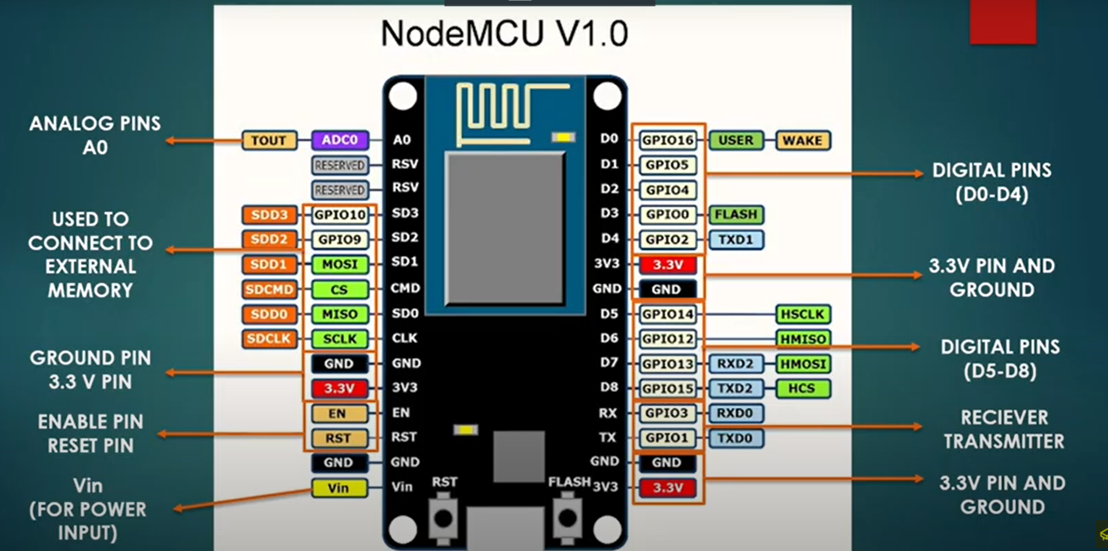
Node MCU V 1.0

Slide 7
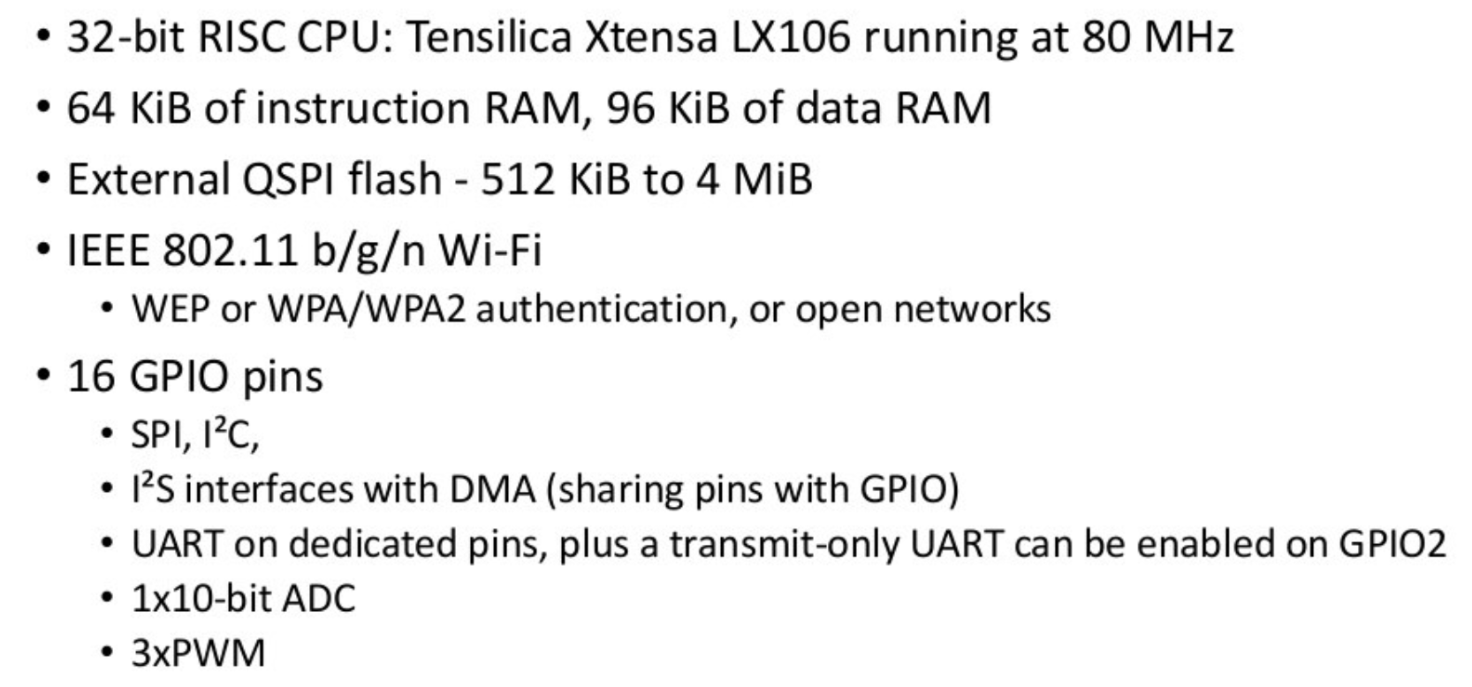
ESP8266

Slide 8
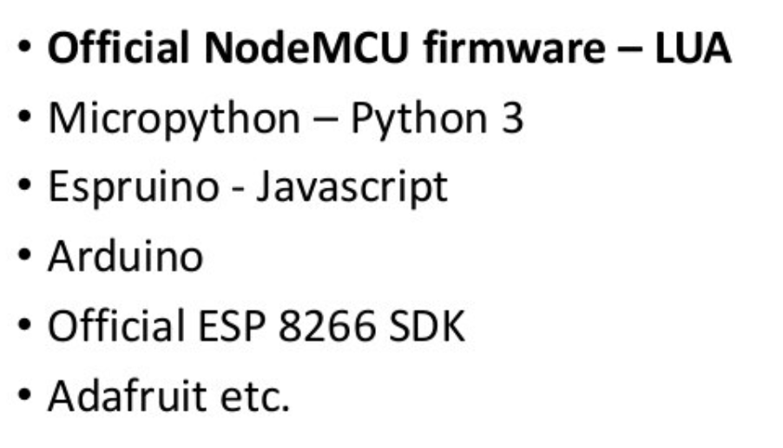
Softwares supported

Slide 9
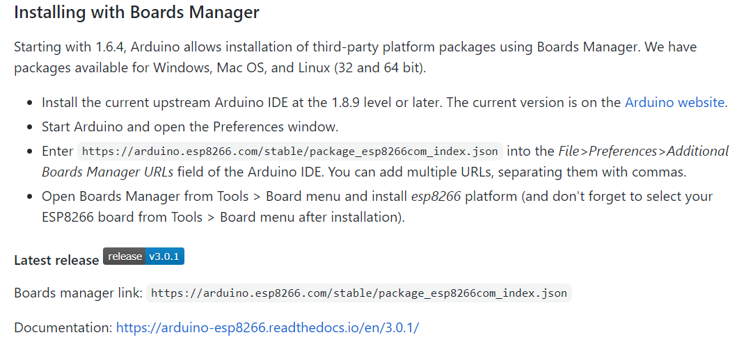
Installing Boards Manager

Slide 10
Developer | ESP8266 Opensource Community
Type | Single-board microcontroller
Operating system | XTOS
CPU | ESP8266^{[1]}(LX106^{[2]})
Memory | 128kBytes
Storage | 4MBytes^{[3]}
Power | USB
Website | www.nodemcu.com, API reference: nodemcu.readthedocs.io

Slide 11
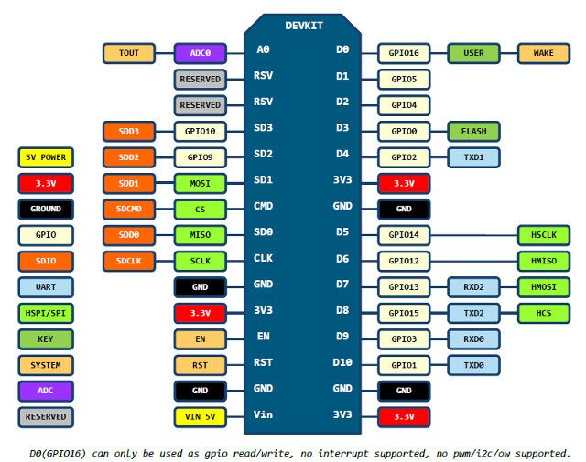

Slide 12
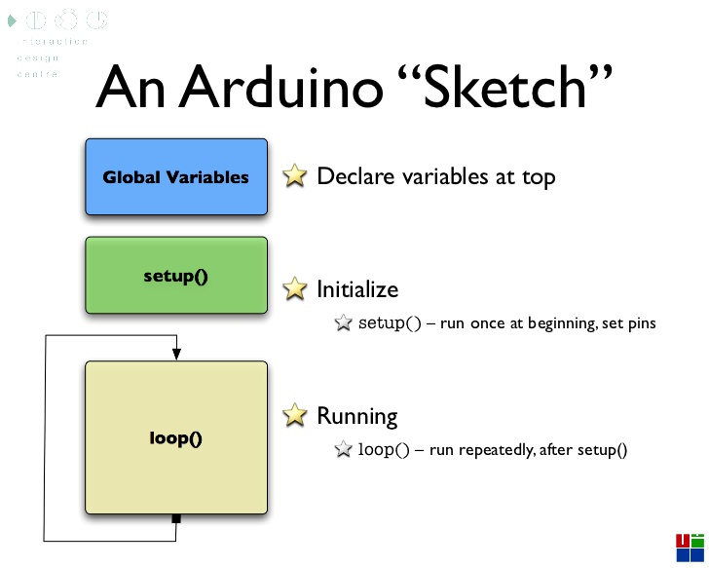

Slide 13
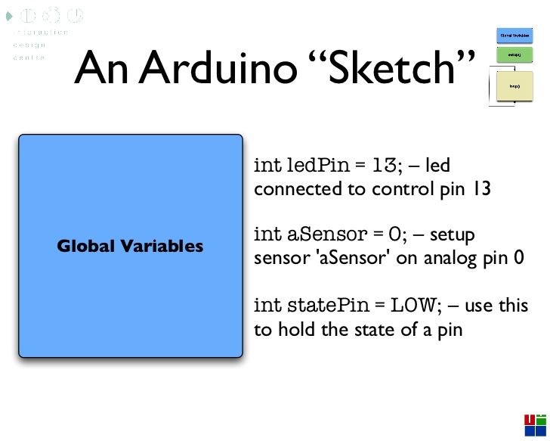

Slide 14
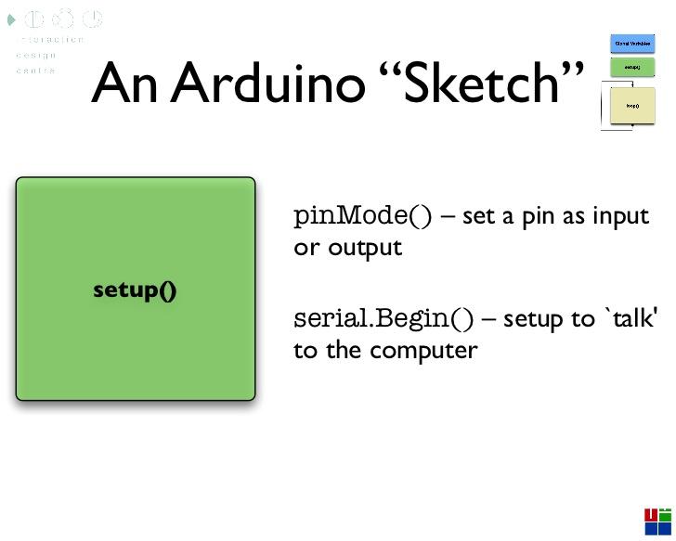

Slide 15
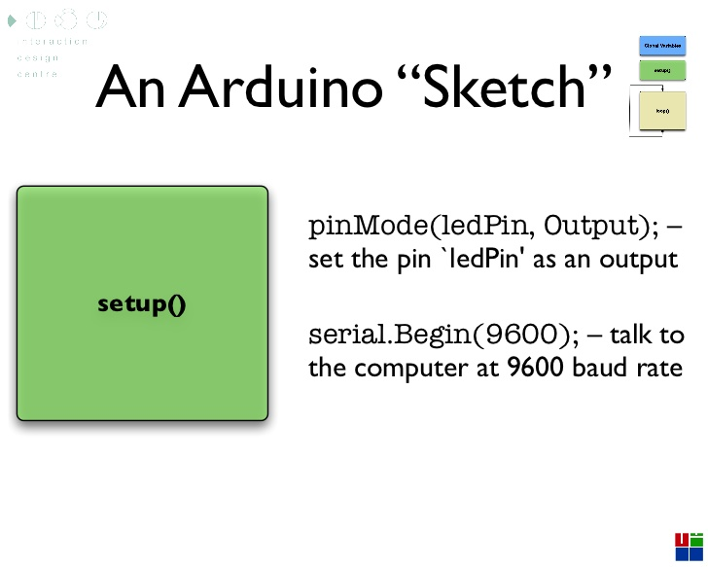

Slide 16
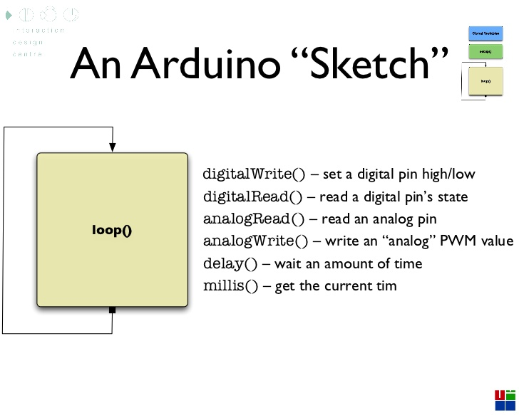

Slide 17
Blinking Led
int LED1 = D3;
int LED2 = D4;
int LED3 = D5;
void setup() {
Serial.begin(9600);
pinMode(LED1, OUTPUT);
pinMode(LED2, OUTPUT);
pinMode(LED3, OUTPUT);
}
void loop() {
digitalWrite(LED1, HIGH);
digitalWrite(LED2, HIGH);
digitalWrite(LED3, HIGH);
delay(1000);
digitalWrite(LED1, LOW);
digitalWrite(LED2, LOW);
digitalWrite(LED3, LOW);
delay(1000);
}

Slide 18
UART DEMO
void setup()
{
Serial.begin(9600);
}
void loop()
{
Serial.println("Pantech Solutions");
delay(1000);
}

Slide 19
Thank You

